Slide 1

ITCS 6190/8190, Spring 2020
Vector Space Classification
Abdullah Al Raqibul Islam
UNCC ID #801151189

Slide 2
Topics Covered
Vector Space Model
Contiguity Hypothesis
Rocchio Classification
K-nearest Neighbor Classification
Linear Classifiers

Slide 3
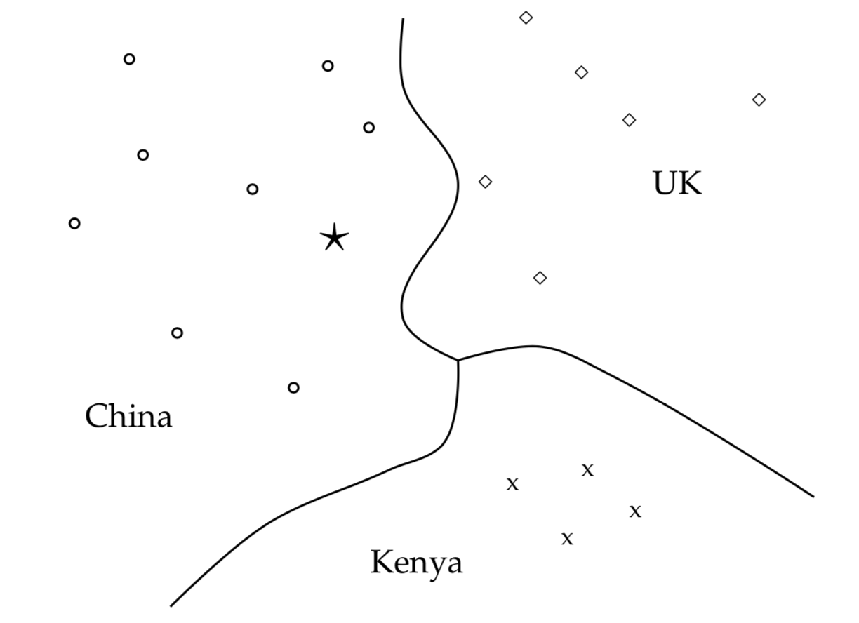
Vector Space Model
Represent collection of documents as a set of vectors in common space
The vector of document has one component for each dictionary term
These documents all share a single common space
Fig: Vector space of word documents
Notes:
In the vector space model, we represent the collection of documents as a set of vectors in common space.
In this model, the vector of document has one component for each dictionary term.
These documents all share a single common space.
For example in the figure we can see an example of vector space of word documents.

Slide 4
Contiguity hypothesis
Documents in the same class form a contiguous region
Regions of different classes do not overlap
Fig: Vector space classification into three classes
Notes:
The basic hypothesis in using the vector space model for classification is the contiguity hypothesis. It says Documents in the same class form a contiguous region and Regions of different classes do not overlap.
In text classification, classes can be distinguished by word patterns.
For example, documents in the class China tend to have high values on dimensions like Chinese, Beijing, and Mao whereas documents in the class UK tend to have high values for London, British and Queen.
Documents of the two classes therefore form distinct contiguous regions as shown in Figure here. We can draw boundaries that separate them and classify new documents. In the figure we can see the star, as the query document and it classified as Chinese.
But how do we can draw this separators? It is not very hard in this example as the boundary is very clear and can be marked visually. But what about a space of hundreds of dimension and thousands of documents? There are many methods such as using central points or following neighbors. I will discuss about this in my next slides.

Slide 5
Rocchio classification
Good Decision Boundary: A decision boundary that provide high classification accuracy on data unseen during training.
Purpose of Rocchio Classification: Computing good class boundaries by using centroids to define the boundaries.
Notes:
Let’s discuss about the rocchio classification. Rocchio classification is a method of calculating class boundaries in the vector space.
Let’s first discuss about what decision boundary is. The boundaries in the figure, which we call decision boundaries, are chosen to separate the three classes. The boundaries here is chosen arbitrarily. To classify a new document, depicted as a star in the figure, we determine the region it occurs in and assign it the class of that region, here it belongs to China. Our task in vector space classification is to devise algorithms that compute good boundaries where “good” means high classification accuracy on data that is unseen during training.
One of the best-known way of computing good class boundaries is Rocchio classification, which uses centroids to define the boundaries.

Slide 6
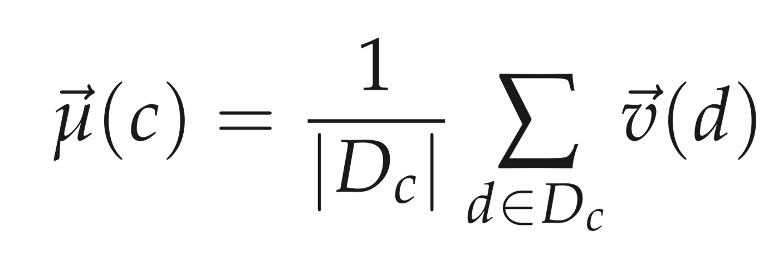
Rocchio classification (Cont.)
The centroid of a class c is computed as the vector average or center of mass of its members:
Where D_{c} is the set of documents in D whose class is c: D_{c} ={ d : ⟨d,c⟩ ∈ D }

Slide 7
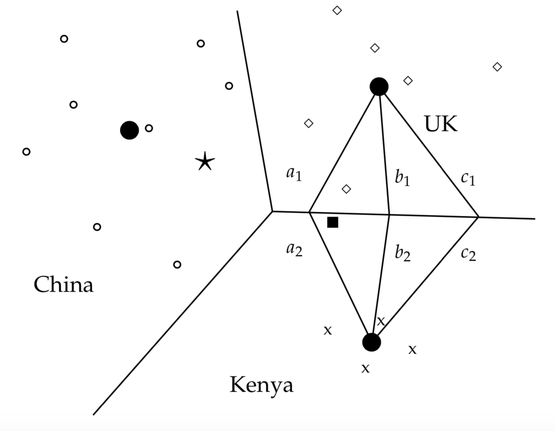
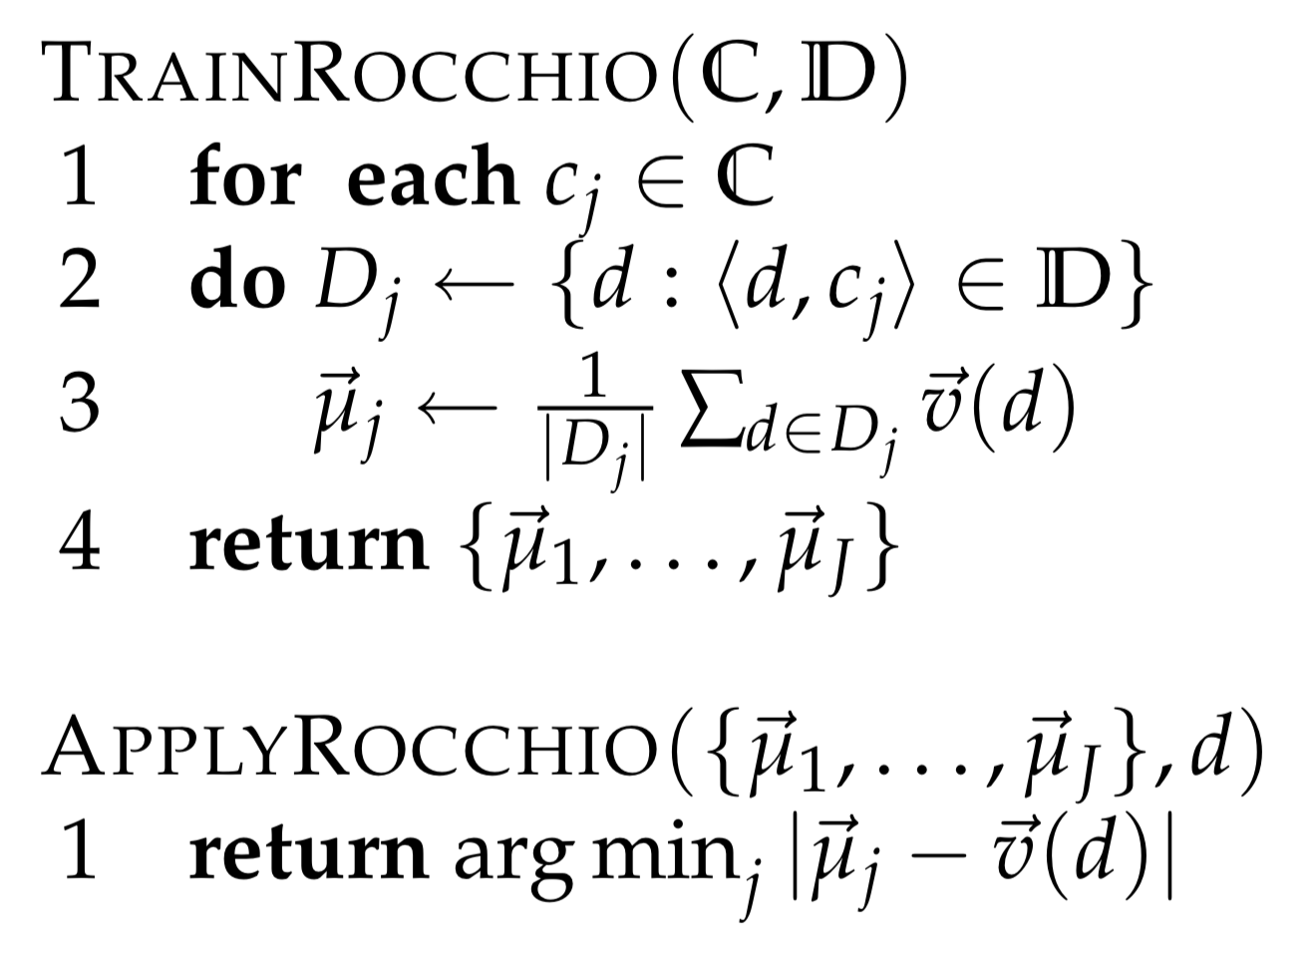
Rocchio classification (Cont.)
|a1| = |a2|; |b1| = |b2|; |c1| = |c2|
Fig: Rocchio classification
Fig: Rocchio classification: Training and testing.
Notes:
Three example centroids are shown as solid circles in the figure.
The boundary between two classes in Rocchio classification is the set of points with equal distance from the two centroids. For example, here (a1, a2) and (b1, b2) and (c1, c2) all are equally distanced from the centroid of UK and Kenya respectively. This set of points create the decision boundary here.
Let’s take a quick look to the algorithm of the Rocchio classification.
In the training phase, each class Cj in set C; which represents the set of all classes, assigns D of the document of the training documents that are in the class Cj.
Next, calculate the centroid of that class of documents by computing the vector average using the normalized vector of all documents of class J.
This function returns a set of centroids.
When applying Rocchio, you will require these set of centroids generated by the Train-Rocchio functuion and the document D. It returns the nearest centroid to the given document.
This is how Rocchio classification work.

Slide 8
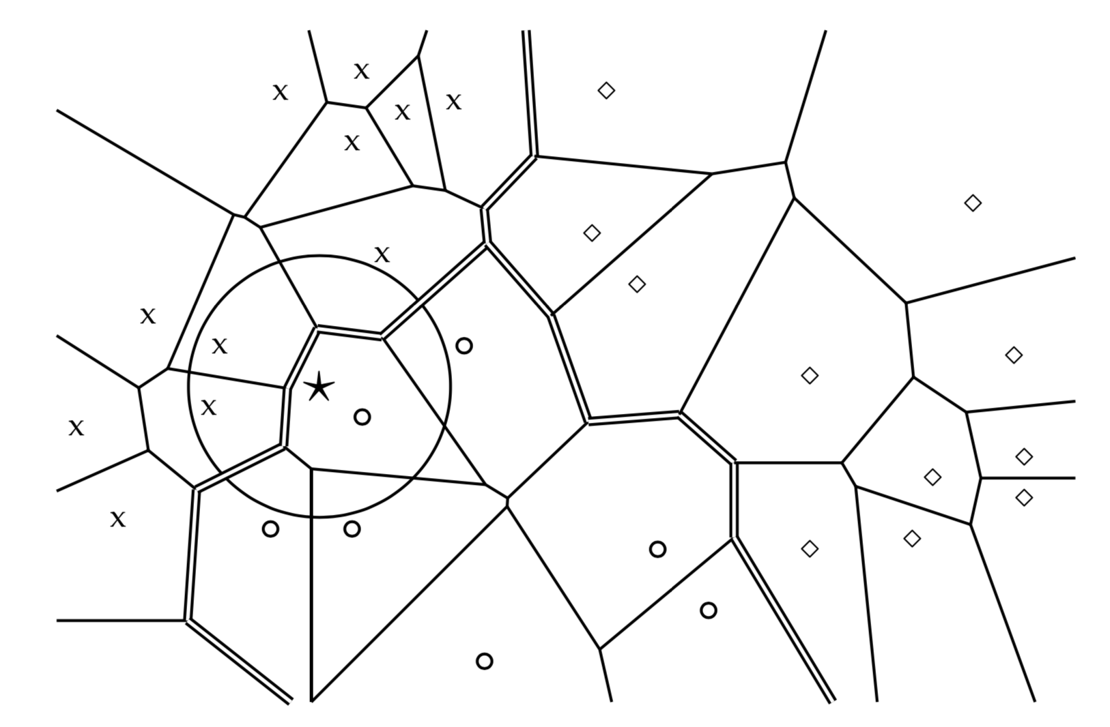
K-nearest neighbor classification
Voronoi Tessellation:
Decomposes space into Voronoi cells
Each object’s cell consists of all points that are closer to the object than to other objects
Selection of K:
K=1 is not a good choice due to high error rate.
K is chosen as odd number to break the ties. K=3,5, 7 … are very common.
Fig: Voronoi tessellation and decision boundaries
Notes:
Now, let’s discuss about the K-nearest neighbor classification.
Unlike Rocchio, k nearest neighbor or kNN classification determines the decision boundary locally. In k nearest neighbor, instead of assigning each documents to the nearest centroid, a document is assigned to the class of it’s “K” nearby neighbors. This comes from the idea that a document being the same class as other nearby documents.
For k equals 1, we assign each document to the class of its closest neighbor.
Decision boundaries in 1NN are concatenated segments of the Voronoi tes-sellation as shown in the figure here. The Voronoi tes-sellation of a set of objects decomposes space into Voronoi cells, where each object’s cell consists of all points that are closer to the object than to other objects. In our case, the objects are documents. The Voronoi tes-sellation then partitions the plane into D convex polygons, each containing its corresponding document as shown in the Figure, where a convex polygon is a convex region in 2-dimensional space bounded by the lines.
For general k is an element of N in kNN, consider the region in the space for which the set of k nearest neighbors are the same. This again is a convex polygon and the space is partitioned into convex polygons, within each of which the set of k nearest neighbors is invariant.
Selection of K is a non-trivial task. The parameter k in kNN is often chosen based on experience or knowledge about the classification problem at hand. It is desirable for k to be odd to make ties less likely. k = 3 and k = 5 are common choices, but much larger values between 50 and 100 are also used. An alternative way of setting the parameter is to select the k that gives best results on a held-out portion of the training set.

Slide 9
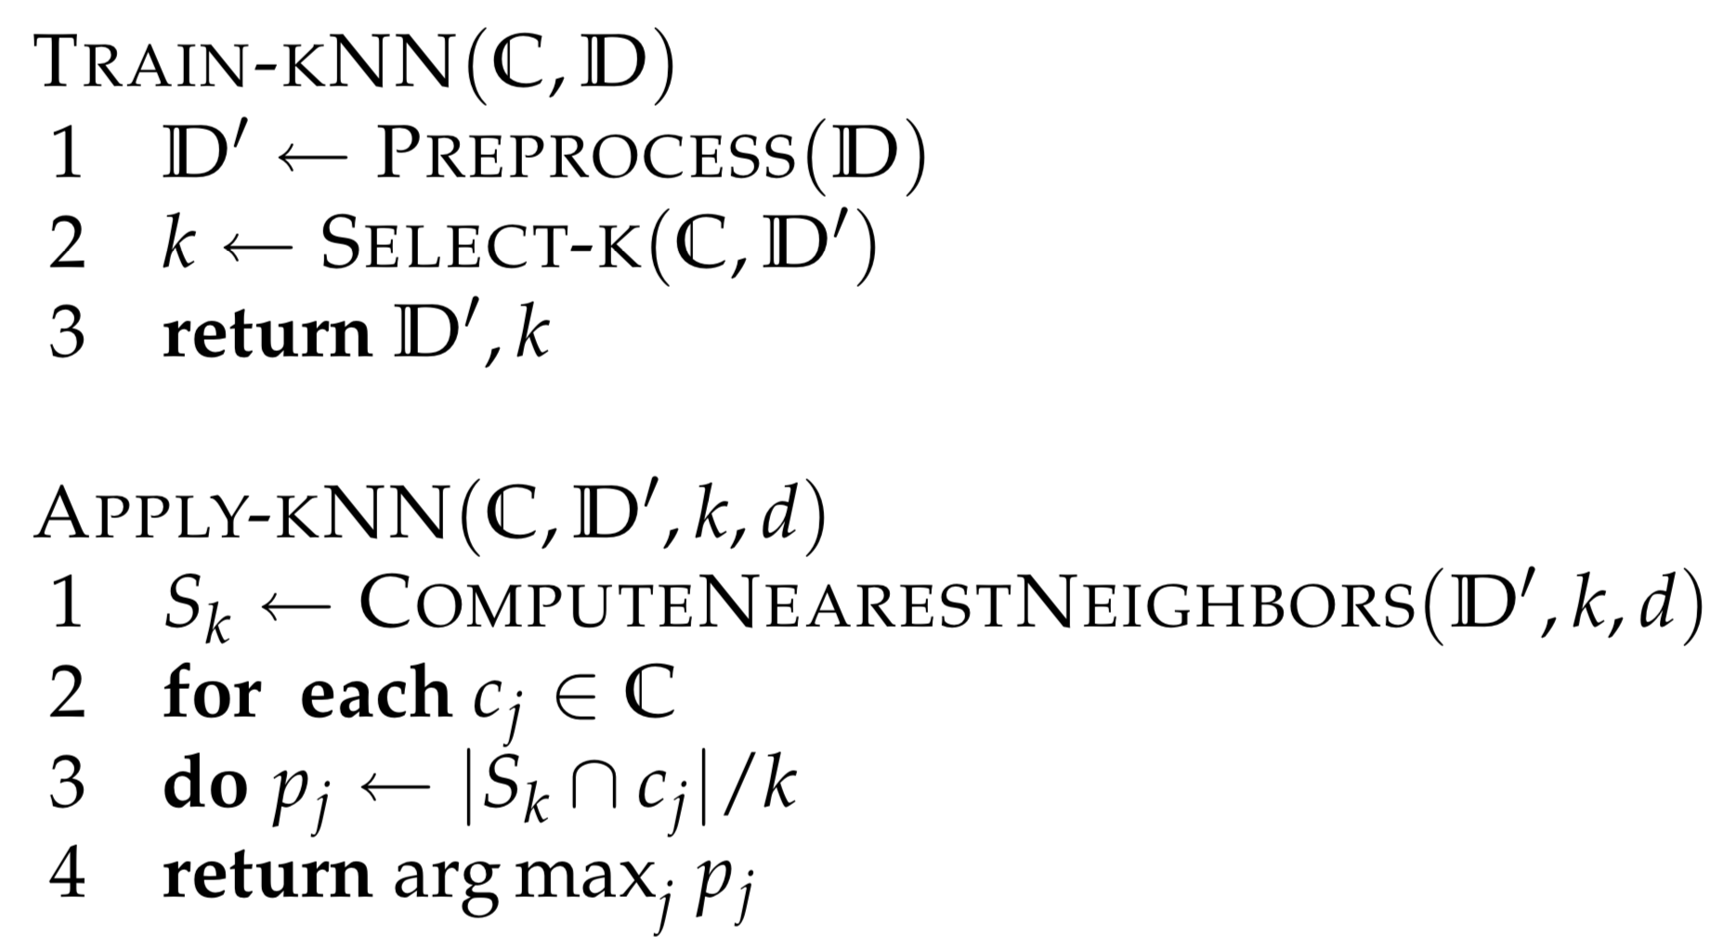
K-nearest neighbor classification (cont.)
Fig: kNN training (with preprocessing) and testing.
Fig: Voronoi tessellation and decision boundaries
Notes:
Let’s take a look to the Training and Using the standard k nearest neighbor algorithm.
K nearest neighbor is very simple to train. The only steps are preprocessing the documents and selecting a value for k.
Preprocessing steps includes the steps like tokenization. It is possible to run k nearest neighbor without preprocessing, but that is less efficient overall. If the documents are not preprocessed in the training stage, it has to preprocessed each time a test document is added.
Selection of k has been discussed in the previous slide.
Applying K nearest neighbor involves selecting the nearest neighbors of the given documents. Then every possible class, estimate the probability that given document is in that class based on the intersection of the given document’s neighbors and the selected class. It then returns the class that gives the highest probability.

Slide 10
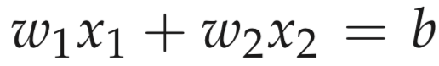
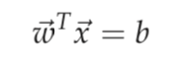
Linear classification
Line equation: … eq(1)
w₁x₁ + w₂x₂ > b … eq(2)
w₁x₁ + w₂x₂ <= b … eq(3)
w₁x₁ + w₂x₂ + w₃x₃= b … eq(4)
… eq(5)
Notes:
Now let’s discuss about the linear classifier in the vector space.
Probably you can understand from the previous discussion, that Rokio classifier is a linear classifier and K-nearest-neighbor is a non-linear classifier. So what is that actually mean?
To keep it simple, I will discuss about linear classifier as a two-class classifier that decides class membership by comparing a linear combination of the features to a threshold.
The separator between one class and another changes depending on the dimension of the vector space. In a two dimensions, the separator is a line. The separator is a plane in a three dimensional space. And hyperplane in many dimensional space.
Let’s start with 2 dimensional space. The line has a form like equation 1. X1 and X2 representing the document and w1 and w2 along with the b makes the decision boundary. If w1, x1 and w2, x2 is greater than b, then the document is assigns to a class C. On the other hand if w1, x1 and w2, x2 is less than or equal to b, then the document is assigns to the complement of class C. Thus it makes the boundary.
We can simply generalize this for higher dimensional space. A plane in 3 dimensional space can be defined by equation 4. A hyperplane in higher dimensional space can be defined by equation 5.

Slide 11
Linear classification (cont.)
Linearly Separable
Notes:
If it is possible to linearly separate the data, then it is called linearly separable.

Slide 12
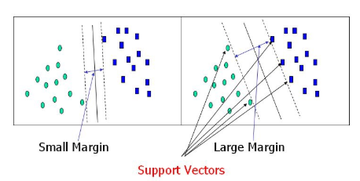
Linear classification (cont.)
Linearly Separable
Infinite Hyperplane
Notes:
If the data is linearly separable, then there exist infinite number of hyperplanes that can separate the data. It is a big challenge to choose the correct hyperplane to choose in the classifier. Some will behave correctly for the new data, and others will not.

Slide 13
Linear classification (cont.)
Linearly Separable
Infinite Hyperplane
Other Linear Classifier
Perceptron
Support Vector Machine
Notes:
There are other types of linear classifier, such as perceptron and support vector machine, which iterate over the dataset and usually perform better than simple linear classification. Rokio, Naive Bias, kNN … they consider simple classifiers. They generate the classifiers directly from the training data, they don’t iterate.

Slide 14
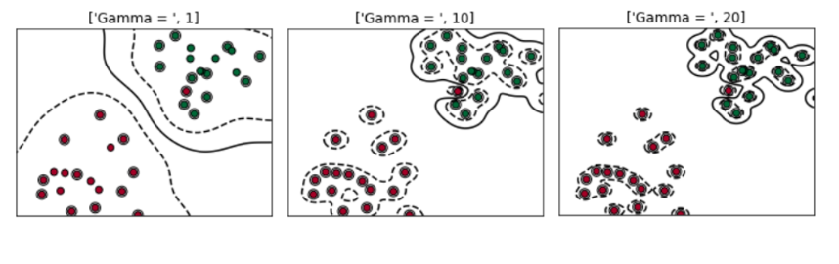
Linear classification (cont.)
Linearly Separable
Infinite Hyperplane
Other Linear Classifier
Perceptron
Support Vector Machine
What if the dataset is not linearly separable?
Notes:
Not all the datasets are linearly separable, not matter what classifier we are using. If the data naturally forms complex shapes, non linear classifier suggest k-nearest neighbor as the much better option. A linear classifier will not work for those dataset.

Slide 15
References and further reading
Rocchio, J. J. 1971. Relevance feedback in information retrieval. In Salton (1971b), pp. 313–323. 181, 193, 314, 530
Joachims, Thorsten. 1997. A probabilistic analysis of the Rocchio algorithm with tfidf for text categorization. In Proc. ICML, pp. 143–151. Morgan Kaufmann. 314, 525
Hastie, Trevor, Robert Tibshirani, and Jerome H. Friedman. 2001. The Elements of Statistical Learning: Data Mining, Inference, and Prediction. Springer. 286, 314, 315, 347, 523, 524, 531
Ghamrawi, Nadia, and Andrew McCallum. 2005. Collective multi-label classification. In Proc. CIKM, pp. 195–200. ACM Press. DOI: doi.acm.org/10.1145/1099554.1099591. 315, 523, 527
Notes:
Okay, now I am going to wrap up my today’s presentation. Here is some reference and further reading if you feel this topic interesting.

Slide 16
Questions?
Notes:
I will take a question from you.

Slide 17
When performing the text classification, the axis of the Vector Space represent what?
Notes:
Thank you for your question.
When performing the text classification, the axis of the vector space represents the dictionary terms of the documents.

Slide 18
Thank You
Notes:
Thank you for participating in the today’s presentation session.

